Slide 1
Spotting the Red Flags in Academic Publishing: Predatory Journals and Their Consequences
Helgi Sigurbjörnsson – librarian research service
helgi.sigurbjornsson@landsbokasafn.is
rannsokn@landsbokasafn.is

Slide 2
Predatory publishing has a long and interesting history.
It has its roots in a publication form called vanity publishing that was developed for established publishing houses to be able to publish books by unknown authors that had no foreseeable market value. The publisher would print the book, but the author would pay for everything. This model was beneficial to both parties. The author could get his first book out, even if it would likely flop, and the publishing house took no financial risk by publishing the book but established a relationship with the author that might later become famous. Some famous books have been published this way, for example Lewis Carroll ‘s Through the looking glass.
This model is problematic because it creates a potential revenue stream for the publisher not from selling the final product (books or journals), but from selling a service to the author. That in fact has created a scenario where the publisher can potentially act fraudulently towards the author.

Slide 3
Enter the fraudsters/ predators…
In 1941 the publisher C.M. Fulmiani was sentenced to 18 months in jail for mail fraud. He operated a publishing business where he would trick people into publishing books in his vanity press. The fraud was set up like this: The author would send in a manuscript to an agency run by Fulmiani. Fulmiany would then send several rejection letters to the author purporting to be from known publishers, but all praising the manuscript somehow. “Your story is a masterpiece of modern literature, but unfortunately it isn’t for us. Don’t loose heart, your story simply must be heard”.
After a number of these letters the author would start to get desperate, but at the same time determined to find a publisher. Then Mr. Fulmiani would send a new letter introducing a vanity publishing house that would be willing to publish the book if the author would pay the bill. The author would jump at the opportunity and Fulmiani would charge excessively for every step in the publishing process urging the author to pay for more and more copies. In the end the author was stuck with a truckload of unsellable books of low quality.

Slide 4
The vanity publishing model and scientific publishing
Until recently the scientific journal publishing model has largely remained unchanged. It resembles the vanity publishing model in a few ways. When the first journals were published in 17th century the audience was a small community of only a few universities. The potential for a publishing house to break even on publishing these journals was so unlikely, that it was deemed proper for the authors and peer reviewers to not only work pro bono but even pay a fee to get published. The universities would then pay the scholars and reward them for their work. It was sensible at that time, but since then the audience and potential for revenue for the publishers has grown exponentially.
With the rise of free open access publishing a new chapter was formed in this saga as reputable publishers aligned their business models even more with the vanity press model by creating the “golden open access” – A business model that asks the author to pay not only the fees of yesteryears, but additionally pay for open access. This extra fee is based on the perceived revenue the publisher might have gained had the article been published behind a paywall.
The scientific community is partly driven by the publish or perish dogma and therefore scientists need to find publishers for their work, even when the most reputable publishers will not publish. That is when you run the risk of encountering questionable publishers.
The difference that matters between a reputable publisher and a questionable or predatory publisher is that the former claims to offer robust peer review and does so, but the latter makes the same claim but doesn’t. There are other differences, but they are not as important.

Slide 5
What is it that a predatory publisher does?
Offers a publication in a journal that is different from what it appears.
Does not maintain the strict quality control (peer review) that occurs in an academic publication but pretends to do it.
Accepts all subjects (quantity over quality)
Focuses the publication's income on "services to authors" rather than sales of the journal.
Publishes often and in large quantities at once (the more articles, the more profit)
Refers to impact factors that are false /and or artificial.
Attempts to get paid for everything (preferably from the author and his organizations.)
Likely to take your paper hostage if you realize your mistake.
Floods the market with subpar research articles and endangers the overall quality of academic research
Emulates legitimate publishers. F.ex webofsciences in place of webofscience

Slide 6
Some examples of red flags:
Rapid publishing - The peer review process is given an unrealistically short time (e.g., 2 weeks).
Claims to be open access but is not listed in doaj.org (Directory of Open Access Journals).
The journal isn’t in a specific field, or the articles don’t follow the stated scope of the journal.
A huge number of published articles per issue.
The publisher doesn’t appear in Scopus CiteScore or Clarivate InCites.
The journal homepage has an amateurish look (spelling errors, Gmail, etc.).
The publisher sends spam emails requesting articles, often filled with praise for the author.
The editorial board is made up of scholars who don’t recognize that they are affiliated with the journal or don’t exist.
The Journal Website is focused on the authors rather than the readers.
Predatory Publishing The business model is mainly focused on profiteering from the authors but not on selling access to the journal. The things promised (robust peer review, impact factor, etc.) turn out to be fake.

Slide 7
More red flags
Submission fee or handling fee implying payment to submit
Retraction fee
Publishing fees are unclear
The journal has a similar name to a legitimate journal
The journal cites false indexing, including f.ex. Google Scholar and Copernicus
Submission of articles is through an email rather than a publishing platform

Slide 8
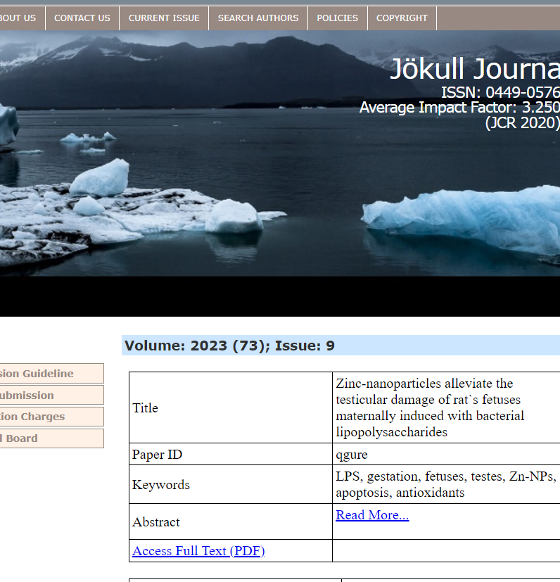
Types of questionable journals/publishing
Fast track publications– the peer review process is too short to allow for proper peer review, e.g. about 2 weeks. – advertise it
Special issue publishers – Publishers publish a large number of special issues in this and that field.
Mega journals – play on the impact factor.
Hijacked journals – pretend to be another journal
Notes:
Fast-track publications – the peer review process for reputable publications is usually several months. However, some publications pride themselves on publishing articles quickly. That can be interesting for researchers who need just a few points in the annual assessment for permanent employment. Keep in mind that the peer review process takes time, you need to find two specialists on the subject to review the article, and they need to be willing to do so, that will inevitably take some time. Then the process itself will take time and is likely to consist of more than just a single response to criticism.
Special issue publishers - Special issues do not receive impact factors (Impact factor) because they are one-time editions and therefore more difficult to verify - The publishers invite inexperienced scholars to become editors – it is a "great honor". Then the publisher receives articles from people connected to this scholar, but the publisher’s work is poor.
Mega Journal: Thousands of articles or even tens of thousands of articles published per year. As a result, the number of references to the journal's articles is higher than in a journal that publishes 10 articles a year. It results in a higher impact factor (Impact factor) until the publication is removed from the list, which happens regularly. These journals begin life as normal publications, where the rules are mostly followed for three years. However, when the publication enters the systems that measure impact factors Clarivate InCites and Scopus citescore, the working methods change, there is little or no peer review except in name, and the speed of publication becomes high. These publications play on the impact factor in such a way that the volume of the articles leads to a higher citation rate (a million articles in one paper will collectively receive more references than ten articles in another paper). [The author publishes an article in such a paper, writes another article that appears in another paper. There he refers to the article he published at the super magazine. There is a reference that will raise the paper's impact factor. ]
Stolen journal (Hijacked journal) Very clearly a fraudulent activity. A scammer sets up a website and advertises for articles in the name of another magazine. Jokulljournal.com is an example of such a parasite. May lead to difficulties for the publication that is affected by the theft.

Slide 9
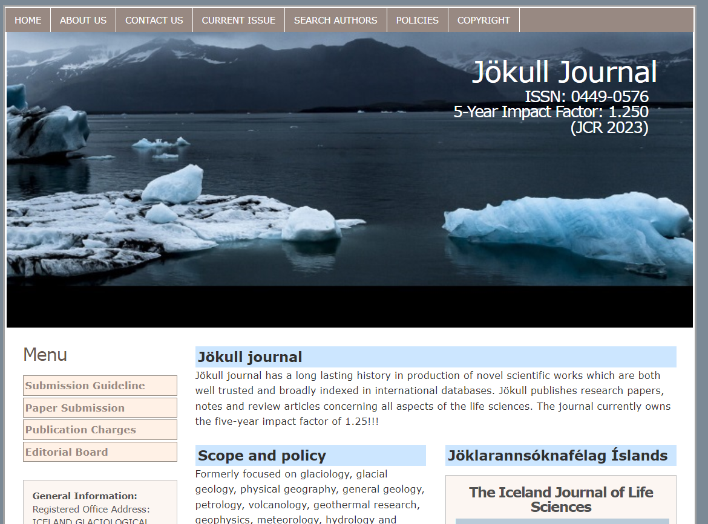
An example of a hijacked journal

Slide 10
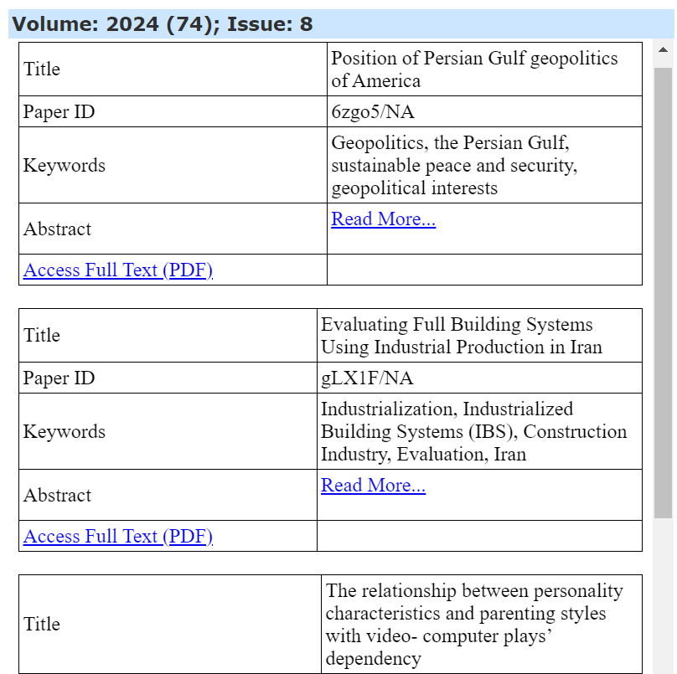
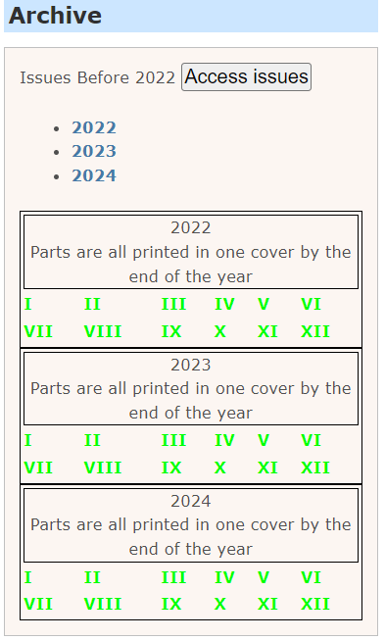
Red flags apparent in Jökull journal

Slide 11
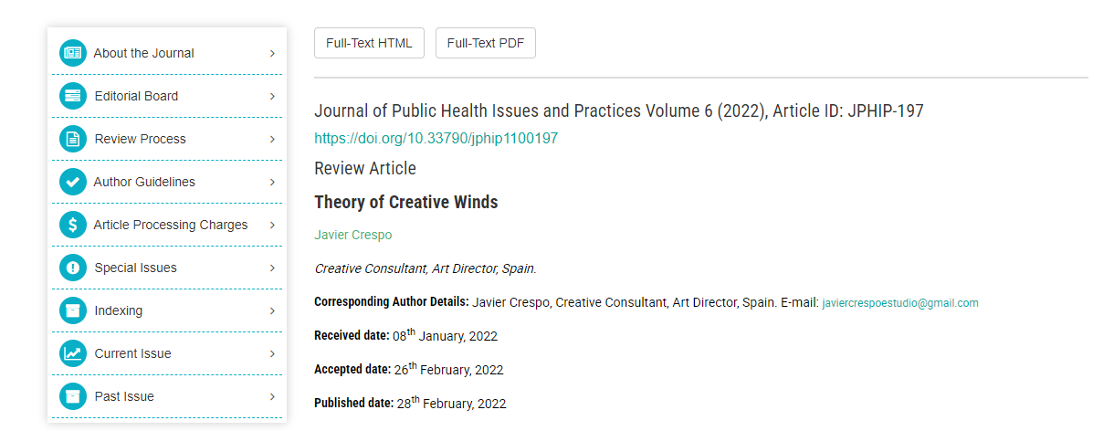
Example of fast-track publication
Journals that advertise fast-track publication can seldom be trusted.
Peer reviewers need to be specialists in the subject the article is about. It takes time to find those specialist and get theyr acceptance to review. Good peer review also takes time..
Notes:
Gexin publishing.

Slide 12
A typical wording of a letter from a dubious publisher
We are reaching out to you because we have identified you as a leading researcher in your field. At the Global Journal of Emerging Sciences, we are dedicated to publishing groundbreaking research and innovative studies, and we believe your work would be a perfect fit for our next issue. We invite you to submit your manuscript for consideration.
Notes:
Filled with praise
Another type of letter offers you to become an honorary editor or peer reviewer wihtout needing to any of the work – This basically means that the publisher is going to use your name to legitimize his editorial practice

Slide 13
Mega-Journals
Getting a journal into Clarivate InCites and Scopus CiteScore (the two leading impact factors ) takes about 3 years.
The first 3 years of a Mega-Journal it adheres to normal publishing practices, but once they have got on the lists they change tempo and the amount of articles published jump from tens to hundreds or thousands of articles per year. Acceptance rate of articles is high and the articles are in a very wide area.
These journals are regularily delisted from InCites and CiteScore, but until that happens they enjoy an unusually high impact factor.
Notes:
Some publishers that othervice are considered trustworthy are also guilty of these kind of practices, for example Nature!

Slide 14
Special issue publications
A scholar is contacted and invited to become the guest editor of a special issue, as he is, of course, at the forefront of his field.
Articles are then obtained from those familiar with this scholar. All the work of the publication is minimal and poorly executed, but the publication may still be usable, thanks to the efforts of individual editors.
The results will be published as a special issue, featuring a collection of a very large number of articles. Since it is a one-time publication, it will never appear on journal lists.
Notes:
Igi global er ekki rányrkjuútgefandi og hefur verið mikið nýtt af fræðimönnum Háskóla Íslands – Ég raunar vil ekki segja neitt til um þennan útgefanda eða gæði hans af eða á, en starfshættirnir eru þannig að ég myndi ekki mæla með þeim.

Slide 15
What happens if you publish with a predatory publisher?
Serious threat to the integrity of research
Researchers and consumers may be affected
Reputation of authors could be damaged
Errors, once published, will be cited
Notes:
Segja frá Lorna Wilgaard

Slide 16
Can you request to withdraw your paper from a predatory journal?
Yes – but:
„As per our policies, a withdrawal fee of 40% on the APC, totaling 929 Euros, would apply to withdraw your article from our journal.“
The article will be taken hostage.
Notes:
Lorna Wilgaard

Slide 17
Consequences of submission
You need to contact Vísinda- og nýsköpunarsvið for assistance
If you resubmit to a legitimate journal, declare the submission to the predatory journal and explain the withdrawal.
The predatory journal has a copy of the submitted manuscript and might publish it regardless – in the same journal or a sister publication > You need to monitor this
Keep all correspondence and document all contact with the journal
You need to state on the CV that this publication is being addressed to reduce effects of predatory publication in funding applications
The researcher‘s reputation is tarnished.
Source: Lorna Wildgaard: Predatory publishing 2.0: Spotting the red flags and staying protected [Danish OA week 2024, oral presentation]

Slide 18
Red flags – making sure the journal is usable
Notes:
I should add to this – is the use of stock photos excessive.
Add to: Index Copernicus -

Slide 19
A good way to find a reputable journal

